Slide 1
YOUR RESUME
Julie Carroll, Outcomes Lead

Slide 2
LEARNING OBJECTIVES
YOUR RESUME
Review recent Outcomes Assignments
Understand your resume “user” and their goals and pain points
Develop a strong resume in your field, utilizing human-centered design
Understand key objectives of a cover letter

Slide 3
YOUR RESUME
OUTCOMES ASSIGNMENTS

Slide 4
YOUR RESUME
LET’S SAY YOU’RE A “RECRUITER”…

Slide 5
YOUR RESUME
YOU HAVE 10 SECONDS

Slide 6
YOUR RESUME
RESUME #1

Slide 7
YOUR RESUME
RESUME #2

Slide 8
YOUR RESUME
RESUME #3

Slide 9
YOUR RESUME
RESUMES + HUMAN-CENTERED DESIGN
Who is your user?
What are your user’s goals?
What are your user’s pain points?
What else should you consider?

Slide 10

YOUR RESUME

Slide 11
YOUR RESUME
WHAT MAKES A STRONG RESUME?
Orient your reader within 5 seconds. Impress them within 10.
Focus on where you are going, not where you’ve been.
One page only.*
Objectives are old-school.
Use a headline or summary.
Skills are a great hook.
Provide evidence in Experience.

Slide 12
YOUR RESUME
RESUME TIPS
List your accomplishments, not just your responsibilities.
Make your name BIG.
Your resume needs to be a .pdf.
Live and short links links to online portfolio + any social media that fits.
You don’t have to include college graduation year.

Slide 13
YOUR RESUME
RESUME SECTIONS
WDI RESUMES MUST INCLUDE:
Header: Name, email + phone, clean links to portfolio (+ Github)
Skills: Languages, frameworks, and tools (prominently displayed)
“Experience” or “Relevant Experience” section
GA usually goes here (not in Education)
At least 3 GA projects
These can go under GA or you can have a “Projects” section
Education

Slide 14
YOUR RESUME
RESUME SECTIONS
Optional sections
Summary statement or key accomplishments
Unrelated work experience can go under: “Other Experience,” “Accounting Experience,” “Client-Facing Experience”
Volunteering
Interests (e.g. kayaking, woodworking, filmmaking)
Additional skills (e.g. Native speaker of Spanish)
Non-degree coursework

Slide 15
YOUR RESUME
Header
Header
Skills
GA Experience
Projects
GA Experience
+
Projects
Skills
Other Job Experience
Education
Other Job Experience
Education + Interests
Interests

Slide 16

YOUR RESUME
YOUR TURN

Slide 17
YOUR RESUME
DRAW A MOCKUP OF YOUR SECTIONS
Put yourself in your user’s shoes. What do they want to learn about you?
What proportion of your resume should be devoted to GA/your new skills?

Slide 18
YOUR RESUME
HI-FI

Slide 19
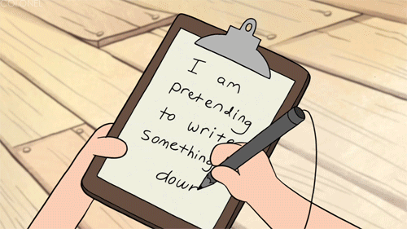
YOUR RESUME
WRITE WORDS
Pick a section and start drafting text

Slide 20
YOUR RESUME
RESUME TEMPLATES
Be careful! Don’t all use the same template.
You don’t need a template – you can build your own resume in Microsoft Word!
Creddle.io
enhancv.com
The Muse: 275 Free Resume Templates in Word
Canva.com

Slide 21
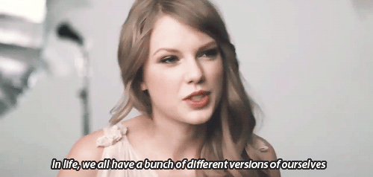
YOUR RESUME
TAILOR, TAILOR, TAILOR
Notes:
Tailor your resume to each specific user!!

Slide 22
HELPFUL ARTICLES
YOUR RESUME
4 Steps to Tailor Your Resume to the Job
Link shorteners: http://lnkdin.me/ and https://goo.gl/ and bitly.com
9 Key things hiring managers want on developer resumes
Beat the ATS: Get your Resume into Human Hands
Resunate -- scan your resume through an ATS
Jobscan.co - similar to Resunate

Slide 23
YOUR RESUME
OUTCOMES ASSIGNMENT

Slide 24
RESUMES
COVER LETTERS

Slide 25
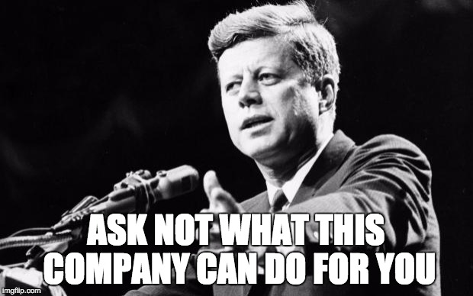
COVER LETTERS
KEY OBJECTIVES:
Why are you excited about THIS job?
Why are YOU the best candidate for this job?

Slide 26
COVER LETTERS: TIPS
Keep it short and sweet (half a page).
Don’t start with your name/introducing yourself. They have that info already.
Do include the hiring manager’s name (research to find it!)
Don’t regurgitate your resume. This is your pitch. Make an argument, not a list.
Don’t apologize for the skills you don’t have.
Use numbers, measureables, key performance indicators.
Think custom, not canned. Tailor, tailor, tailor. Your reader should feel special.
But don’t go too far...like this guy…

Slide 27
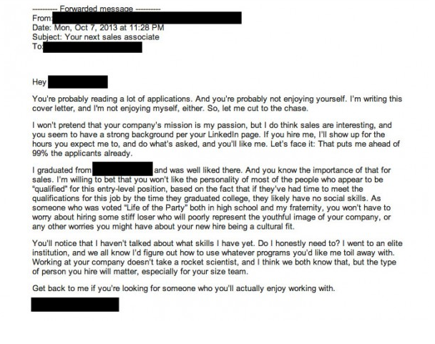
COVER LETTERS

Slide 28
HELPFUL ARTICLES
YOUR RESUME
Cover Letter Basics, The Muse: https://www.themuse.com/advice/the-painfree-cover-letter-builder
How to Write a Cover Letter: 31 Tips You Need to Know , The Muse: https://www.themuse.com/advice/how-to-write-a-cover-letter-31-tips-you-need-to-know

Slide 29
Q&A & Exit Ticket
Developing Your Network
Exit ticket: https://ga-research.typeform.com/to/tKqUa1

